Slide 1
BIT 245
RDBMS With SQL
Sushil Bhattarai
sushil.bhattarai@texascollege.edu.np
Lincoln University College, CN 1221

Slide 2
RDBMS

Slide 3
SQL(Structured Query Language)
Set of commands/Instructions.
To store, access and manipulate data and databases.
standard language for Relational Database System; enables user to create, read, update and delete relational databases and tables.
SQL depends on tuple relational calculus and relational algebra.

Slide 4
Role of SQL
Allows users to access data in the database management systems.
Allows users to describe the data.
Allows users to define the data in a database and manipulate that data.
Allows to embed within other languages using SQL modules, libraries & pre-compilers.
Allows users to create and drop databases and tables.
Allows users to create view, stored procedure, functions in a database.
Allows users to set permissions on tables, procedures and views.

Slide 5
Official SQL Standards
SQL became a standard of the American National Standards Institute (ANSI) in 1986, and of the International Organization for Standardization (ISO) in 1987.
The standard has been revised to include a larger set of features.
Despite the existence of standards, most SQL code requires at least some changes before being ported to different database systems.

Slide 6
Microsoft Support
Depending on the version and edition of SQL Server, SQL Server can be installed on a supported Windows operating system and Linux as well.
SQL Server Installations are supported on x64-based (AMD and Intel) processors.
Microsoft supports deploying SQL Server on virtualization technologies that include Microsoft Hyper-V and other certified Virtual Machines.
The supported file systems are NTFS and ReFS on Windows. This applies to the volumes that store the database files and program binaries.
The supported file systems for the volumes that host database files are EXT4 and XFS for Linux systems.
Customers with a support plan can open a ticket with Microsoft support.
There is a huge SQL Server community for assistance.
You can also get help by searching and posting questions on Microsoft Q & A.
There are communities that can help with SQL Server issues such as.
Stack Overflow
DBA Stack Exchange
Reddit
Get help from the community with the #sqlhelp hash tag on twitter

Slide 7
Relational Foundation
The basic principle of the relational model is the Information Principle: all information is represented by data values in relations. In accordance with this Principle, a relational database is a set of relational variables and the result of every query is presented as a relation.
Relational Database is a database system that stores and retrieves data in a tabular format in the form of rows and columns.
Relational DBMS owes its foundation to the fact that the value of each table are related to others. It has the capability to handle larger magnitudes of data and simulate queries easily.

Slide 8
Complete Database Language
SQL is a database language designed for managing data held in a relational database management system.
SQL was initially developed by IBM in the early 1970s.
In a DBMS, the SQL database language is used to: Create the database and table structures.
There are large number of database languages like: Oracle, MySQL, MS Access, dBase, FoxPro, etc.
SQL statements commonly used in Oracle and MS Access can be categorized as Data Definition Language (DDL), Data Control Language (DCL), and Data Manipulation Language (DML).

Slide 9
Client/ Server Architecture
An architecture of a computer network in which many clients (remote processors) request and receive service from a centralized server (host computer).
Client computers provide an interface to allow a computer user to request services of the server and to display the results the server returns.
In order to retrieve the desired data the user present a set of criteria by a query.
Then the DBMS, software for managing databases, selects the demanded data from the database.
The retrieved data may be stored in a file, printed, or viewed on the screen.

Slide 10
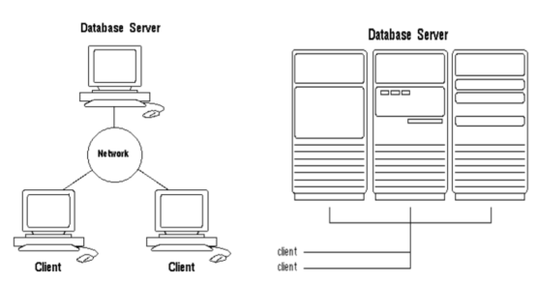
Client/ Server Architecture

Slide 11
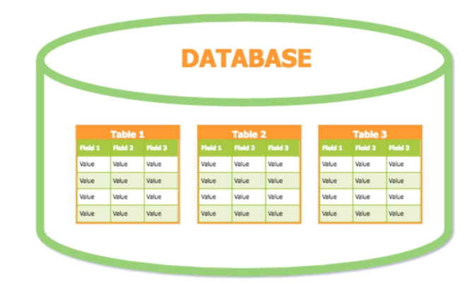
Creating a Database
The following statement is an example of a CREATE DATABASE statement: CREATE DATABASE database_name;
Always the database name should be unique within the RDBMS.

